Slide 1
Reinforcement Learning 2 Markov Decision Process

Slide 2
Topics
Markov Process
Markov Reward Process
Markov Decision Process
Extensions of MDP

Slide 3
Markov Process
Markov Process formally describe an environment for reinforcement learning.
Where the environment is fully observable.
The current state completely characterizes the process.
Almost all RL problems can be formalized as MDPs.

Slide 4
Markov Process
Many problems can be a special case of MDP.
Partials observable problems can be converted into MDPs.
Bandits are MDPs with one state.

Slide 5

Markov Process: Markov State
A State is Markov (has Markov property) if and only if
A state St is Markov if and only if
P[St+1 | St] = P[St+1 | S1,...,St]
The state captures all relevant information from the history.
Once the state is known, the history can be thrown away.

Slide 6
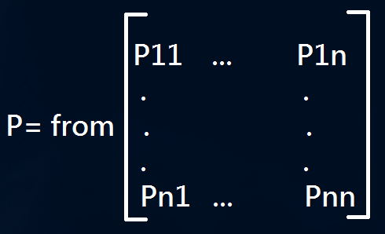
Markov Process : State Transition Matrix
For a Markov state s and successor state s’, the state transition probability is defined by
P_{ss'} = P[S_{t+1} = s' | S_{t} = s]
State Transition Matrix P defines transitions probabilities from all states s to all successor states s’.
Each row of the matrix sum to 1.

Slide 7
Markov Process
A Markov process is a memoryless random process.
(i.e. a sequence of random state S1, S2…with Markov property)
A Markov Process(or Markov chain) is a tuple (S, P)
S is a (finite) set of states
P is a state transition probability matrix

Slide 8
Markov Process: Example
0.9
Wechat
Sleep
1.0
Pass
Sample Episodes from Student Markov Chain starting from S1=C1
C1 C2 C3 P S
C1 W W C1 C2 S
C1 C2 C3 D C2 C3 P S
C1 W W C1 C2 C3 D C1 C2 C3 S
0.5
0.1
0.2
0.6
Class 1
0.5
Class2
0.8
Class3
0.4
0.4
0.4
0.2
Date

Slide 9
Markov Process: Example
0.9
Wechat
Sleep
1.0
Pass
 | C1 | C2 | C3 | Pass | Date | Wechat | Sleep
C1 | - | 0.5 | - | - | - | 0.5 | -
C2 |  |  | 0.8 |  |  |  | 0.2
C3 |  |  |  | 0.6 | 0.4
Pass |  |  |  |  |  |  | 1.0
Date | 0.2 | 0.4 | 0.4
Wechat | 0.1 |  |  |  |  | 0.9
Sleep |  |  |  |  |  |  | 1.0
0.5
0.1
0.2
0.6
Class 1
0.5
Class2
0.8
Class3
0.4
0.4
0.4
0.2
Date

Slide 10
Markov Reward Process
A Markov reward process is a Markov chain with values
A Markov reward process is a tuple <S, P, R, γ>
S : a finite set of states
P : a state transition probability matrix
R : a reward function, R_{s} = E[R_{t+1} | St=s]
γ : discount factor γ є [0, 1]

Slide 11
Markov Reward Process: Example
0.9
1.0
R=-1
1.0
R=+10
R=0
Pass
Wechat
Sleep
Sample Episodes fro Student Markov Chain starting from S1=C1
C1 C2 C3 P S
C1 W W C1 C2 S
C1 C2 C3 D C2 C3 P S
C1 W W C1 C2 C3 D C1 C2 C3 S
0.5
0.1
0.2
0.6
R=-2
0.8
R=-2
R=-2
Class2
Class3
Class 1
0.5
0.4
0.4
0.4
0.2
R=-1
Date

Slide 12
Markov Reward Process: Return
A return of a sample, Gt, is the total discounted reward from the time-step t.
Gt = Rt+1 + γ Rt+2 + γ² Rt+3 + …. = ∑ ∞ γ^{k}R_{k+1}
The discount γ є [0, 1] is the present value of the future rewards
If γ =0, prefer immediate rewards
If γ =1, consider more future rewards

Slide 13
Markov Reward Process: Why discount
The maths works!!!
Uncertainty of the future. We don't have a perfect understanding of the environment, just a model.
Avoids infinite rewards for looping in Markov chain.
Animal behavior shows preference for immediate.
If you sure all sequence terminate, you might choose undiscounted.

Slide 14

Markov Reward Process : State Value Function
A value function, v(s) gives the long-term value of state s
The state value function v(s) of an MRP is the expected return starting from s.
It is to evaluate how good to be on some state

Slide 15
Markov Reward Process : Example
Starting from S1=C1, γ = 1/2
Samples’ return:
C1,C2,C3,P,S G1=-2 - 2 * 1/2 - 2 * 1/4 + 10 * 1/8 = -2.25
C1,WC,WC,C1,C2 G1=-2 - 1 * 1/2 – 1 * 1/4 - 2 * 1/8 – 2 * 1/16=-3.125
C1,C2,C3,D,C2,C3,P,S G1=-2 – 2 * 1/2 – 2 * 1/4 + 1 * 1/8 – 2 * 1/16 – 2 * 1/32+10
* 1 / 64= -3.40
..
..
..
Values function of a state = E[G1 above]

Slide 16
Markov Process: Example
0.9
1.0
1.0
R=+10
R=-1
R=0
Pass
Wechat
Sleep
-1
0
+10
Try γ = 0.0
0.5
0.1
0.2
0.6
R=-2
R=-2
0.8
R=-2
Class 1
0.5
Class2
Class3
-2
-2
-2
0.4
0.4
0.4
0.2
R=+0.8
Date
-1

Slide 17
Markov Process: Example
0.9
1.0
R=-1
R=0
1.0
R=+10
Wechat
Sleep
Pass
0
+10
Try γ = 1.0, consider future
-7.6
0.5
0.1
0.2
0.6
R=-2
R=-2
0.8
R=-2
Class 1
0.5
Class2
Class3
-5.0
0.9
4.3
0.4
0.4
0.4
0.2
R=+0.8
Date
1.9

Slide 18
Bellman Equation
The value function(how good in a state) can be decomposed into 2 parts.
Immediate reward R_{t+1}
Future reward γ * v(S_{t+1})
v(s) = E[G_{t} | S_{t}=s]
= E[R_{t+1} + γ * R_{t+2} + γ² * R_{t+3}) | S_{t}=s]
= E[R_{t+1} + γ * (R_{t+2} + γ * R_{t+3}) | S_{t}=s]
= E[R_{t+1} + γ * G_{t+1} | S_{t}=s]
v(s) = E[R_{t+1} + γ * v(S_{t+1}) | S_{t}=s] ⬅Bellman simplest form

Slide 19
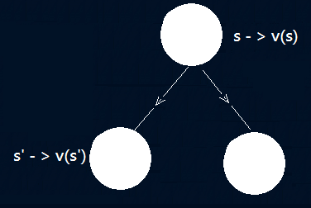
Bellman Equation
v(s) = E[R_{t+1} + γ * v(S_{t+1}) | S_{t}=s]
v(s) = R_{s} + γ * ∑ P_{ss’}v(S’)
s'∈S

Slide 20
Bellman Equation: Example
0.9
1.0
R=-1
1.0
R=+10
R=0
Pass
Wechat
Sleep
V=+10
Try γ = 1.0 with Bellman equation
v(C3) = 4.2 = -2 + 0.6 *10 + 0.4*0.8
V=-7.6
V=0
0.5
0.1
0.2
0.6
0.8
R=-2
R=-2
R=-2
Class3
Class 1
0.5
Class2
V=-5.0
V=0.9
V=4.32
0.4
0.4
0.4
0.2
R=+0.8
Date
V=1.9

Slide 21
Bellman Equation: Example
0.9
1.0
R=-1
1.0
R=+10
R=0
Pass
Wechat
Sleep
Try γ = 0.2 with Bellman equation
v(C3) = 4.32
= -2 + 0.2* 0.6 *10 + 0.2² *0.4*0.8
V=-7.6
V=0
V=+10
0.5
0.1
0.2
0.6
0.8
R=-2
R=-2
R=-2
Class3
Class 1
0.5
Class2
V=-5.0
V=0.9
V=4.32
0.4
0.4
0.4
0.2
Date
R=+0.8
V=1.9

Slide 22
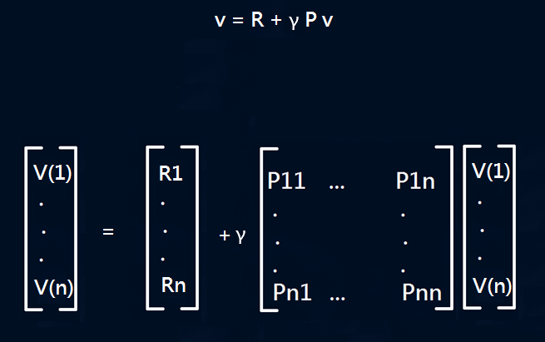
Bellman Equation: as a matrices

Slide 23
Bellman Equation: as a matrices
Being a linear equation: v can be solved by
Computation is O(n³) for n states
Direct solution only possible for small MRPs
There are many iterative methods for large MRPs
Dynamic Programming
Mote-Carlo evaluation
Temporal-Difference Learning
v = R + γ P v
(1- γ P) v = R
v = (1- γ P) ⁻¹R

Slide 24
Markov Decision Process
A Markov decision process is a Markov reward process with decisions. It is an environment in which all states are Markov
A Markov reward process is a tuple <S, A, P, R, γ>
S : a finite set of states
A : a finite set of actions
P : a state transition probability matrix Pª_{ss’} = P[S_{t+1}=s’ | S_{t}=s, A_{t}=a]
R : a reward function, Rª_{s} = E[R_{t+1} | S_{t}=s, A_{t}=a]
γ : discount factor γ є [0, 1]

Slide 25

Markov Decision Process

Slide 26
Markov Decision Process
Wechat
R=-1
Sleep
R=0
Quit
R=0
Wechat
R=-1
Sleep
R=0
Study
R=+10
Study
R=-2
Study
R=-2
Date
R=+1
0.4
0.2
0.4

Slide 27
Markov Decision Process: Policy
A policy is a distribution over actions given states.
π(a | s) = P[A_{t}=a | S_{t}=s]
A policy fully defines the behaviors of an agent.
MDP policy depends on the current state (not history).
Policy is time-independent.

Slide 28
Markov Decision Process: Policy
Given an MDP M = {S,A,P, R, γ} and policy π
The state sequence S1, S2,… is a Markov Process {S, P^{π}}
The state and reward sequence S1, R1, S2,… is a Markov reward Process {S, P^{π} , R^{π} , γ}
P^{π} _{s,s’} = ∑ π(a | s) Pª _{s,s’}
^{aєA}
R^{π} _{s} = ∑ π(a | s) R_{s}ª
^{aєA}

Slide 29
Markov Decision Process: Value Function
The state- value function v_{π}(s) of an MDP is the expected return
starting from state s and then following policy π
v^{π}(s) = E^{π}[G_{t} | S_{t}=s]
The action-value function q_{π}(s, a) of an MDP is the expected return
starting from state s, take action a, and then following policy π
q^{π}(s, a) = E^{π}[G_{t} | S_{t}=s, A_{t}=a]

Slide 30
Markov Decision: Value function
v_{π}(s) = for π(a|s)=0.5, γ=1
Wechat
R=-1
-2.3
0
Study
R=+10
Quit
R=0
Wechat
R=-1
Sleep
R=0
Study
R=-2
Study
R=-2
7.4
-1.3
2.7
Date
R=+1
0.4
0.2
0.4

Slide 31
Markov Decision: Bellman Expectation Equation
The state-value function can again be decomposed into immediate reward plus discounted value of successor state,
v^{π}(s) = E^{π}[R_{t+1} + γ * v^{π}(S_{t+1}) | S_{t}=s]
The action-value function can similarly be decomposed,
q^{π}(s, a) = E^{π}[R_{t+1} + γ * q^{π}(S_{t+1,} a_{t+1,}) | S_{t}=s, A_{t}=a]

Slide 32
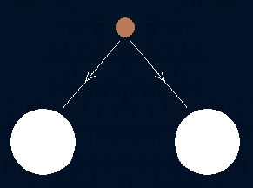
Bellman Expectation Equation for q^{π}
q_{π}(s, a) = Rª_{s} ⁺ γ ∑ Pª_{ss'} v^{π}(s')
^{s'єS}
q^{π}(s,a) <- a
v^{π}(s’) <-s’

Slide 33
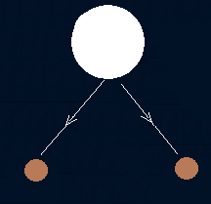
Bellman Expectation Equation for v^{π}
v^{π}(s) <-s
v^{π}(s) = ∑ π(a | s) q^{π}(s, a)
^{aєA}
q^{π}(s,a) <- a

Slide 34
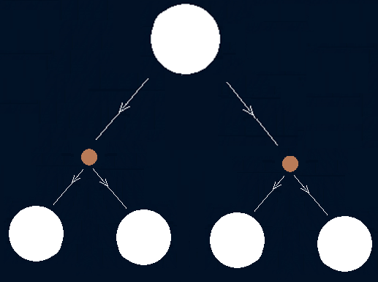
Bellman Expectation Equation for v^{π}
v^{π}(s) <-s
q^{π}(s,a) <- a
v^{π}(s’) <-s’
v^{π}(s) = ∑ π(a | s) (Rª_{s} ⁺ γ∑ Pª_{ss'} v^{π}(s'))
aєA s'єS

Slide 35
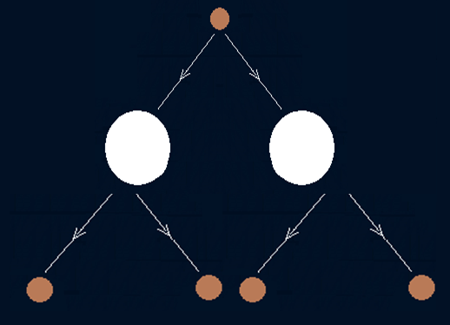
Bellman Expectation Equation for q^{π}
q^{π}(s,a) <- a
v^{π}(s’) <-s’
q^{π}(s, a) = Rª_{s} ⁺ γ ∑ Pª_{ss'} ∑ π(a'|s')q^{π}(s',a')
^{s'єS a'єA}

Slide 36
Bellman Expectation Equation
7.4=0.5*(1-0.2*1.3+0.4*2.7+0.4*7.4) + 0.5*10
Wechat
R=-1
-2.3
0
Study
R=+10
Quit
R=0
Wechat
R=-1
Sleep
R=0
Study
R=-2
Study
R=-2
7.4
-1.3
2.7
Date
R=+1
0.4
0.2
0.4

Slide 37
Bellman Expectation Equation: (Matrix form)
Being a linear equation: v_{π} can be solved by
v^{π} = R^{π} + γ P^{π} v^{π}
(1-γ P^{π}) v^{π} = R^{π}
v^{π} = (1-γP^{π} )⁻¹ R^{π}

Slide 38
MDP: Optimal Value Function
The optimal state-value functions v*(s)
v*(s) = max^{π} (v^{π}(s) )
The optimal action-value functions q*(s, a)
q*(s, a) = max^{π}(q^{π}(s, a))

Slide 39
Bellman Optimality Equation for v*
v*(s) <-s
v^{π}(s) = ∑ π(a | s) q^{π}(s, a)
^{aєA}
v*(s) = max q*(s, a)
^{aєA}
q*(s, a) <- a

Slide 40
Bellman Optimality Equation for q*
q^{π}(s, a) = Rª_{s} ⁺ γ ∑ Pª_{ss'} v^{π}(s')
^{s'єS}
q*(s, a) = Rª_{s} ⁺ γ ∑ Pª_{ss'} v*(s')
^{s'єS}
q*(s, a) <- a
v*(s’) <-s’

Slide 41
Bellman Optimality Equation for v*
v*(s) <-s
q*(s,a) <- a
v*(s’) <-s’
v^{π}(s) = ∑ π(a | s) (Rª_{s} ⁺ γ∑ Pª_{ss'} v^{π}(s'))
aєA s'єS
V*(s) = max (Rª_{s} ⁺ γ∑ Pª_{ss'} v*(s'))
^{aєA s'єS}

Slide 42
Bellman Optimality Equation for q*
q*(s,a) <- a
v*(s’) <-s’
q*(s’, a’) <- a’
q*(s, a) = Rª_{s} ⁺ γ ∑ Pª_{ss‘} ∑ π(a'| s) q*(s', a')
^{s'єS a'єA}

Slide 43
Bellman Optimality Equation for q*
Deﬁne a partial ordering over policies
π ≥ π’ if v_{π}(s) ≥ v_{π’}(s),∀s
Theorem
For any Markov Decision Process
There exists an optimal policy π∗ that is better than or equal to all other policies, π∗ ≥ π,∀π
All optimal policies achieve the optimal value function, v_{π∗}(s) = v∗(s)
All optimal policies achieve the optimal action-value function, q_{π∗}(s,a) = q∗(s,a)

Slide 44
MDP: Optimal Value Function
The optimal policy can be found by maximizing over q*(s, a)
π*(a | s) = 1, if a = argmax(q*(s, a))
0, otherwise ← non linear
There is always a deterministic optimal policy for any MDP.

Slide 45
Markov Decision Process: Policy
Bellman Optimality Equation is non-linear
No closed form solution (in general)
^{Iterative solution}
^{Value}
^{Policy}
^{Q-Learning}
^{Sarsa}

